Slide 1
Project @ Knowledge Representation and Reasoning | 17 January 2025
WiDS Datathon++ 2025 University Challenge Age Prediction from 2D Functional Brain Networks
Ștefana Beatrice Gherghel, Ionel Cătălin Butacu

Slide 2
Topics of today...
Introduction
Data Overview
Data Preprocessing
Model Selection and Testing
Best Model: Elastic Net Regression
Results of the experiment
Challenges and Future Work
Conclusion

Slide 3
Introduction
This project focuses on predicting age using 2D functional brain networks (connectomes) from fMRI data, provided by the Healthy Brain Network (HBN).
The goal is to build a regression model to predict age based on brain connectivity and metadata while exploring sex-specific differences in brain development.

Slide 4
Data Overview
Dataset Size:
Training Samples: 1,104 participants.
Test Samples: 474 participants.
Connectivity Matrix Shape: 200x200 (flattened into 19,900 features).
Metadata: 14 features (provided additional demographic, clinical, and psychological information)

Slide 5
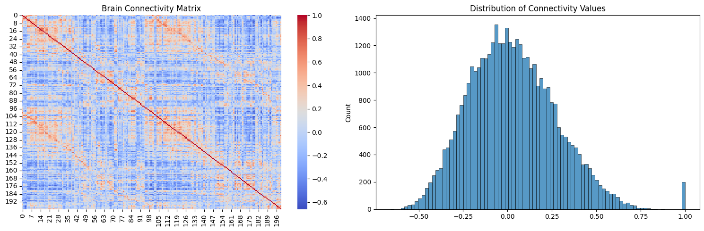
Data Overview
Connectivity Matrix

Slide 6
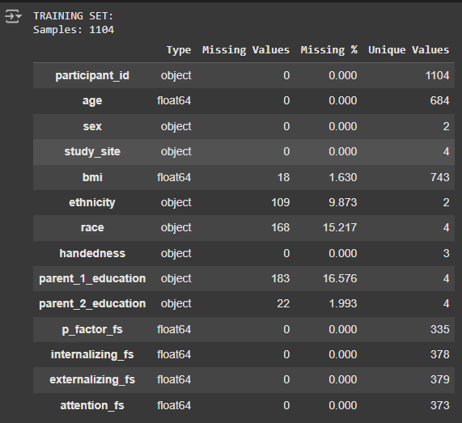
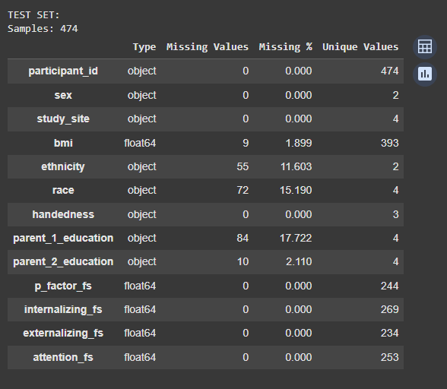
Data Overview
Metadata missing ratio

Slide 7
Data Preprocessing
Handling Missing Values:
Numerical Features:
Missing values in numerical features (e.g., psychological scores) were imputed using mean imputation and KNN imputation of k=50.
Categorical Features:
Missing values in categorical features (e.g., ethnicity, race) were filled with 'Unknown'.
Handling Outliers:
The values that were over the third standard deviation were eliminated, removing the outliers and remaining with 95% of the total data.

Slide 8
Data Preprocessing
Feature Exclusion:
Individuals without BMI values were excluded from the training set due to the major feature importance.
Parent education features were excluded due to high missing values and low relevance.
Feature Encoding:
Categorical variables (e.g., sex, ethnicity, race) were one-hot encoded for regression models.

Slide 9
Model Selection and Testing
Models Tested
Model | Kaggle RMSE | Notes
Elastic Net (Best Model) | 1.81073 | Best-performing model with hyperparameter tuning.
Bayesian Regression | 1.83686 | Performed well but slightly worse than Elastic Net
LASSO (k=11) | 1.83884 | Good performance with k=11 splits.
LASSO (k=5) | 1.87295 | Slightly worse than LASSO with k=11.
XGBoost | 1.95789 | Moderate performance, worse than Elastic Net.
Random Forest | 2.25605 | Poor performance compared to Elastic Net.
SVR (Support Vector Regression) | 2.33567 | Poor performance compared to Elastic Net.
Linear Regression | 2.34491 | Baseline model with moderate performance.
Stepwise Regression | 2.41402 | Poor performance, similar to Linear Regression.
DECISIONAL TREE | 3.22916 | Worst-performing model, likely due to overfitting.

Slide 10
Hyperparameter Tuning
GridSearchCV
used to exhaustively search over a specified parameter grid
RandomizedSearchCV
used to sample a fixed number of parameter combinations from a specified distribution. It was useful for exploring a wide range of hyperparameters efficiently.
HalvingGridSearchCV
uses successive halving to eliminate poor-performing parameter combinations early in the search process.

Slide 11

Best Model: Elastic Net Regression
Model Overview
The Elastic Net model combines L1 (Lasso) and L2 (Ridge) regularization to prevent overfitting and handle multicollinearity in the data.
Hyperparameter Tuning
Alpha: Controls the overall strength of regularization.
L1 Ratio: Determines the mix between L1 and L2 regularization.
Cross-Validation: A range from 5 to 15 fold cross-validation was used to ensure the model generalizes well to unseen data, best performance was on 11 folds.

Slide 12
Results of the experiment
The best hyperparameters were found using GridSearchCV, which was optimized for the lowest root mean absolute error.
The model achieved an RMSE of 1.81073 on the Kaggle test set, making it the best-performing model in this project.

Slide 13
Challenges and Future Work
Challenges
Try another regression techniques like LARS, Huber Regression, and OrthogonalMP to see if they can outperform Elastic Net.
Create from scratch a new model or combining existing models
Future Work
Improve data quality from dataset
Find ways to emphasise more the relevant features for model
Continue WiDS competition further :))

Slide 14
Conclusion
The Elastic Net model outperformed all other models, achieving the lowest RMSE on the Kaggle test set. The success of this model can be attributed to its ability to handle multicollinearity and its robust hyperparameter tuning process.

Slide 15
That was all! Questions!?

